Slide 1
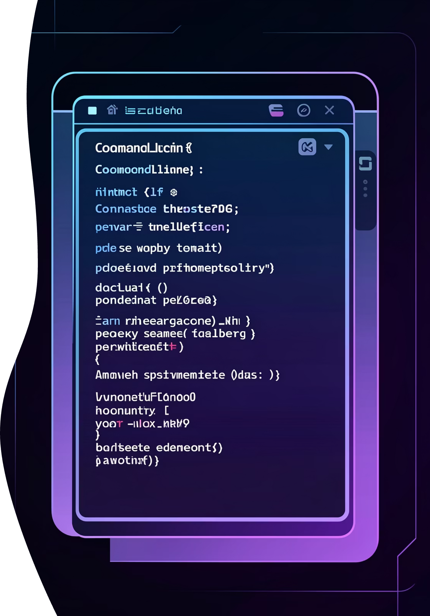
PowerShell Fundamentals
Mastering task automation and configuration management for IT professionals

Slide 2

INTRODUCTION
What is PowerShell?
PowerShell is Microsoft's powerful task automation and configuration management tool, built on the .NET framework. It's designed specifically for system administrators and IT professionals who need to streamline repetitive tasks and manage complex environments efficiently.
Primary Applications
Automating routine system administration tasks
Managing files, folders, and directory structures
Administering Windows systems, Azure cloud services, and enterprise servers

Slide 3
CORE CONCEPTS
Understanding Cmdlets
Definition
Syntax Pattern
Common Examples
Cmdlets are built-in PowerShell commands following a consistent Verb-Noun naming convention that makes them intuitive and discoverable.
Every cmdlet follows the same structure: an action verb paired with a specific noun describing what's being acted upon.
Get-Process
Get-Service
Start-Service
Stop-Service
Verb-Noun

Slide 4
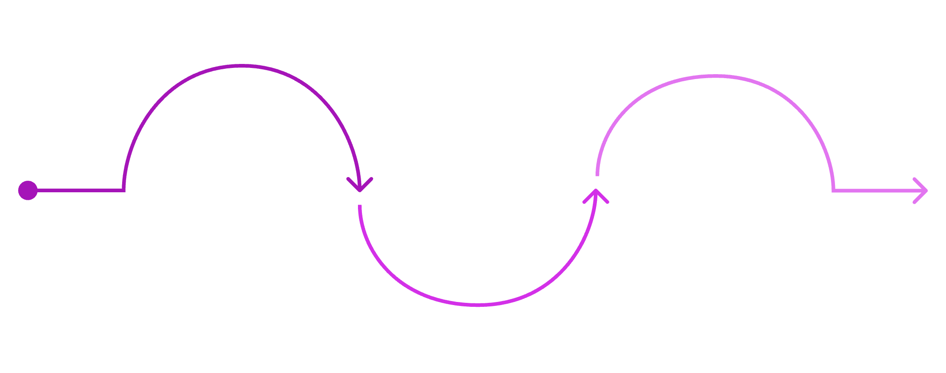
Essential Building Blocks
Variables
Variables store data and always begin with the $ symbol. They're dynamically typed and can hold any object.
Variables
Output
$name = "Saurabh"
$age = 25
Write-Output $name
Store data; begin with $
Pipelines
Display results to the console
Chain commands using |
Pipelines
The pipeline operator | passes output from one cmdlet as input to another, enabling powerful command chaining and cleaner code.
These three elements form the foundation of PowerShell scripting, enabling you to store information, transform data, and create powerful command chains.
Get-Process | Sort-Object CPU

Slide 5
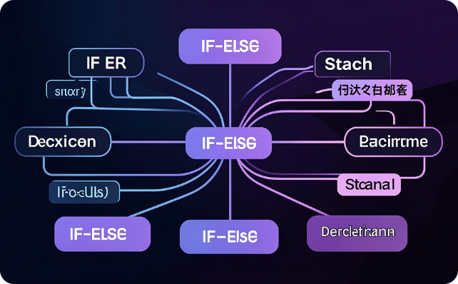


LOGIC & FLOW
Control Flow Structures
Control flow statements allow your scripts to make decisions and repeat actions, forming the logic backbone of automation.
Conditional Statements
For Loops
Foreach Loops
Use if and else to make decisions based on conditions. Perfect for validation and branching logic.
Execute code a specific number of times with precise control over iteration.
Iterate through collections, processing each item individually. Ideal for arrays and lists.
for ($i=1; $i -le 5; $i++) {
Write-Output $i
}
if ($age -ge 18) {
Write-Output "Eligible"
}
foreach ($name in $names) {
Write-Output $name
}

Slide 6


SCRIPTING
Creating PowerShell Scripts
What is a Script?
Execution Policy
A PowerShell script is a text file containing PowerShell commands, saved with a .ps1 extension. Scripts enable you to save and reuse complex command sequences.
If Windows blocks your script, you'll need to adjust the execution policy. This security feature prevents unauthorised scripts from running.
Example Script
$name = Read-Host "Enter your name"
Write-Output "Hello $name"
Set-ExecutionPolicy RemoteSigned
This allows locally created scripts to run whilst requiring downloaded scripts to be signed by a trusted publisher.
Running Your Script
.\hello.ps1

Slide 7




Automating Common Tasks
PowerShell excels at automating repetitive file operations and system administration tasks, saving hours of manual work.
File Operations
Directory Management
System Services
New-Item test.txt -ItemType File
Copy-Item test.txt backup.txt
Remove-Item test.txt
New-Item Logs -ItemType Directory
Get-ChildItem
Get-Service
Start-Service spooler
Stop-Service spooler

Slide 8

ADVANCED
Functions and Modules
Functions
Functions are reusable blocks of code that perform specific tasks. They accept parameters and can return values, making your scripts more maintainable.
function Add-Numbers {
param ($a, $b)
return $a + $b
}
Add-Numbers 10 20
Modules
Modules are collections of functions and scripts stored in .psm1 files. They help organise large projects and share functionality across scripts.
Import-Module AzureAD
Get-Module -ListAvailable

Slide 9







QUICK REFERENCE
Key Concepts Summary
Cmdlets
Variables
Pipelines
Scripts
Follow Verb-Noun naming convention
Always start with $ symbol
Chain commands using | operator
Saved as .ps1 files
Automation
Functions
Modules
File operations and system tasks
Reusable code blocks
Collections of related scripts

Slide 10
Essential Interview Insights
PowerShell is object-based, not text-based
Unlike traditional command-line tools, PowerShell works with .NET objects, providing richer data manipulation capabilities.
Pipelines pass objects, not strings
This fundamental difference enables more powerful and precise command chaining than traditional shell scripting.
Use Get-Help for comprehensive documentation
PowerShell's built-in help system is extensive. Master Get-Help to become self-sufficient.
Functions improve code reusability
Well-designed functions make your scripts more maintainable and reduce duplication.
Modules organise large-scale projects
As your PowerShell expertise grows, modules become essential for managing complex automation solutions.

